Slide 1


Fielding Primary School
Parent Eco Initiatives
Summer 2018 to January 2019

Slide 2
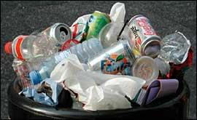
Fielding PTFA initiative
Why? Many parents were unhappy with the waste produced at the PTFA events.
Introduced:
Fielding branded water bottles and cups
Deposit reusable hot & cold drinks cups
Craft stalls centred on recycling and upcycling
Recycling incentive stall
Goodbye single use!

Slide 3
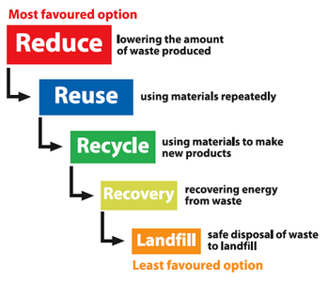
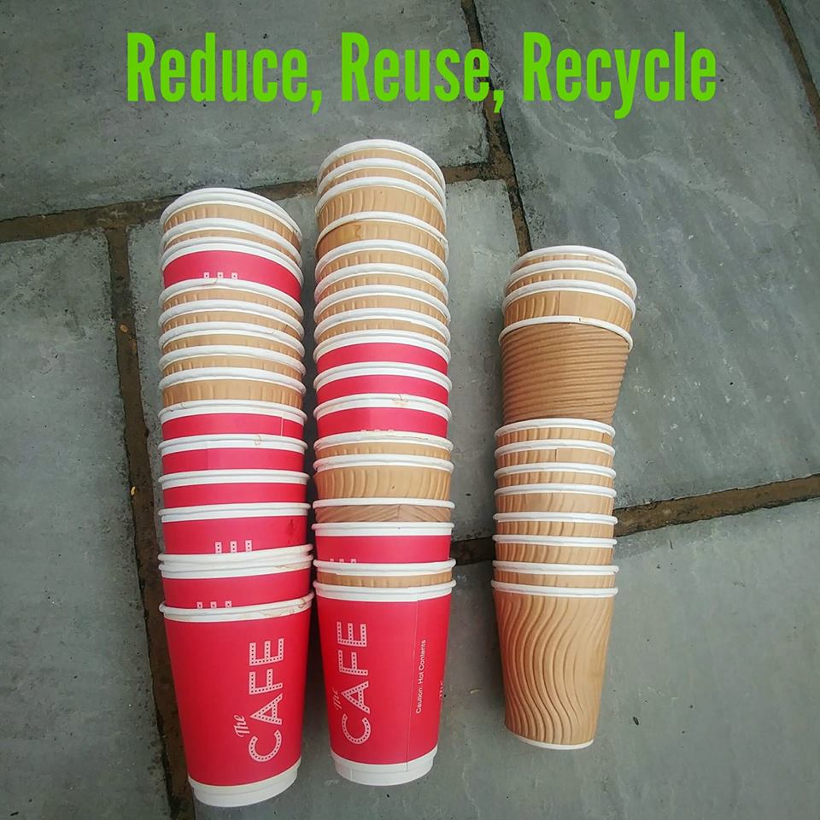
Recycle disposable hot drinks cups
Remember it’s a step process
We had disposable hot drink cups in stock so used up at events and recycled at Costa

Slide 4
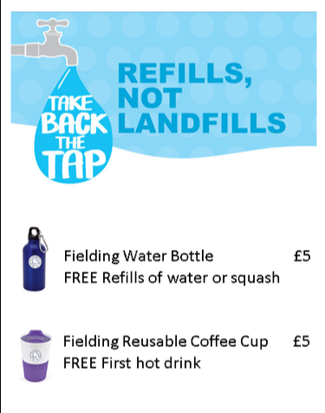
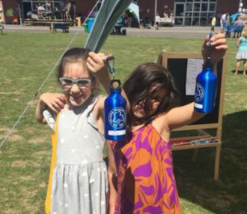
Fielding Branded water bottles
Reusable Bottles sold out at 2018 summer fair
Included unlimited free squash and tap water
No bottled drinks such as Fruit shoot
Results:
Reduced mineral water bottle sales
Significant reduction in plastic bottles.
No disposable cups
Beeline Promotions
www.beeline-promo.co.uk

Slide 5

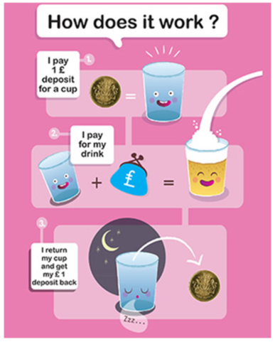
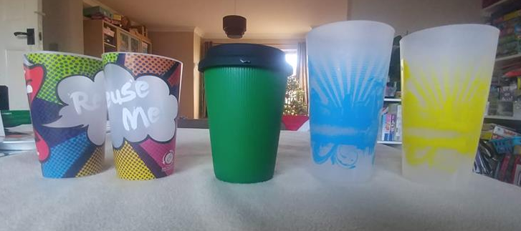
Reusable cold and hot drinks cups
Refill not landfill:
Saving the world one cup at a time
Pound deposit scheme on pint/half pints/hot drinks
Company Sponsorship so no cost to PTFA
Waitrose glass lending scheme for evening events
Saved over 1,000 disposable cups from going to landfill
Feedback has been really positive. Some confusion but easily overcome
Supplied by Green Goblet
www.green-goblet.com

Slide 6
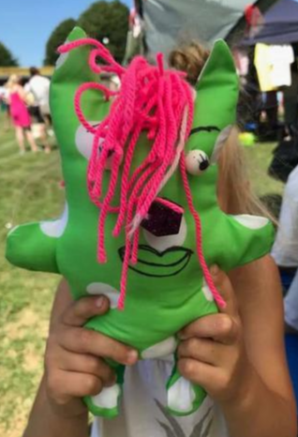
Crafts stalls: Upcycling & Recycling
Crafts stalls along sustainable themes:
  Upcycling t shirts into bags and hairbands
  Fabric offcuts and upcycled stuffing into fabric monsters
  Make Christmas Cards from old cards
Parents always happy to find a sustainable craft

Slide 7
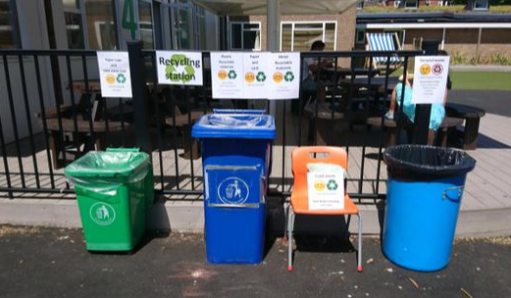
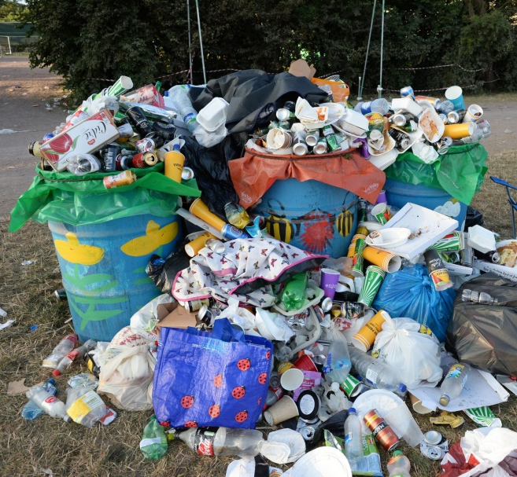
Recycling issues at events
Set up Waste and recycling team to sort waste
Sadly this was a dirty job as general waste was put on top of recycling and so was covered in bin juice.
Before
After (Or something similar!)

Slide 8
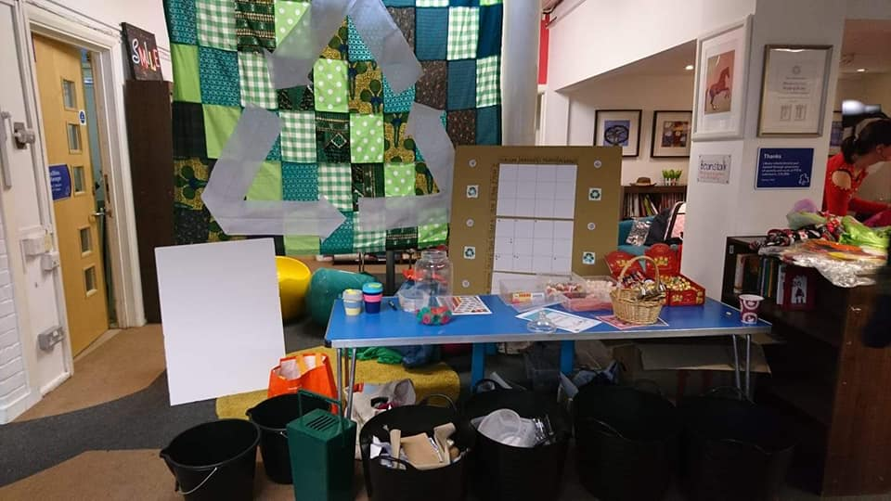
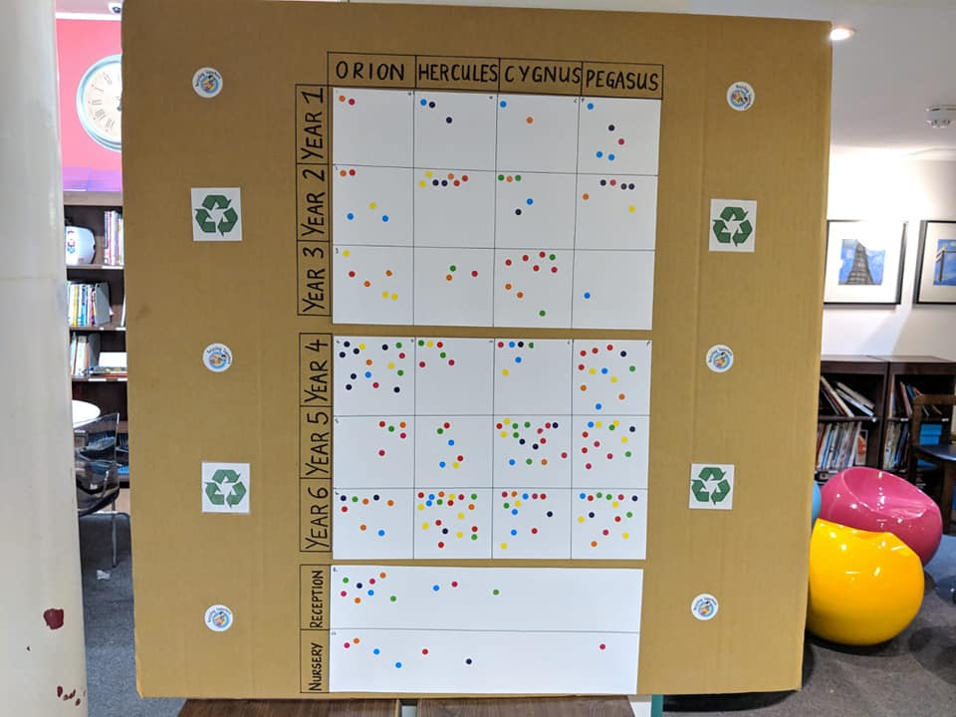
SOLUTION:
Recycling reward stall
Recycling reward stall Children were rewarded for delivering and sorting recycling at the stall. Rewards were:
  Penny sweets
  School house points
Recycling material sorted & no bin juice!
Kids loved it and kept coming back with more…

Slide 9

Going green:
What we accomplished
Replacing disposable cups.
Reducing single use bottles: cordial instead of fruit shoots, tap water available.
Sustainable craft stalls
Recycling team set up
Feedback from parents and teachers are very happy with what we have accomplished.
What next?
Crisps and Sweet wrappers

Slide 10
Thank you

