Slide 1

‘Driving the Transition’
Crowd-sourced from 3 ‘Sustainable Cities’ Events in 2018

Slide 2

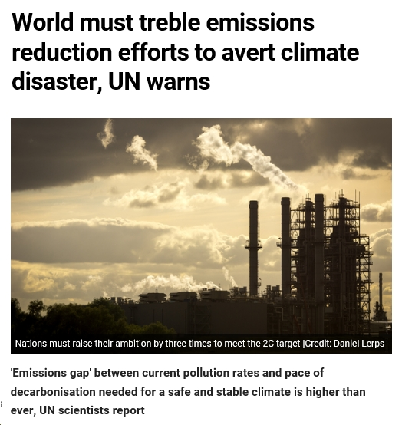
The Climate ‘Emergency’

Slide 3
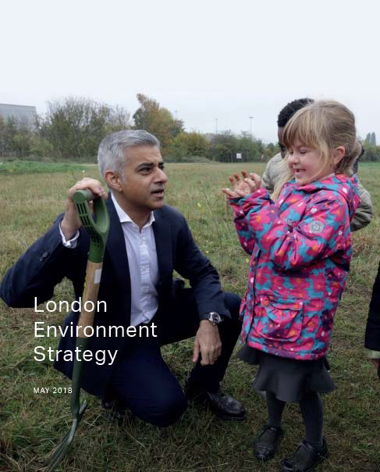
Working with the Mayor’s Strategy
The greenest global city
Zero Carbon by 2050
Zero waste by 2050
2 GW solar capacity
Best air quality of any major world city
More than 50% green space
10% more tree cover

Slide 4
Transport

Slide 5
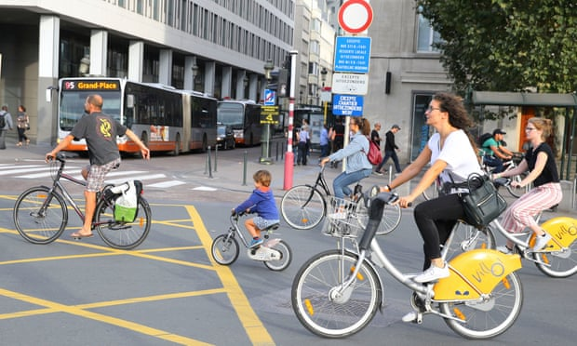
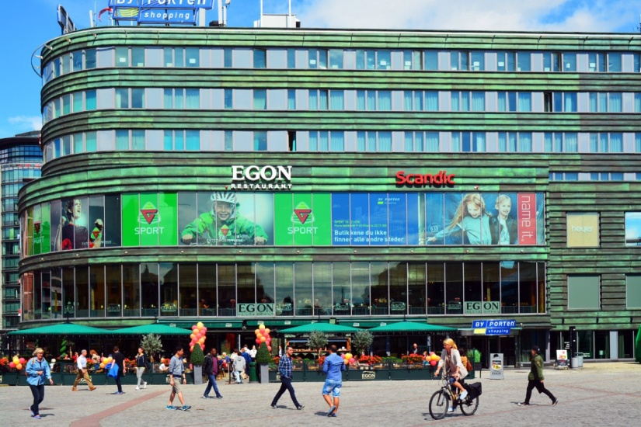
The End of the Petrol Engine?
  Oslo will ban cars from its city centre from 2019. Madrid will remove cars from 500 acres of city space.
  ‘All it has taken is a pledge, a temporary decree and a few plastic bollards’
  https://www.theguardian.com/commentisfree/2018/sep/19/cut-air-pollution-car-action?CMP=share_btn_fb
  John Vidal, Guardian, 19 Sept 2018

Slide 6

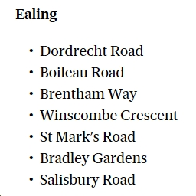
Extend the Scope of Car Free Days
Car Free Days / Cycle Only Days
  Some roads closed in Ealing this year
  The Ealing half Marathon shows what is possible.
  Consider a monthly car free day
  Align with the opening of Crossrail ?
  https://londoncarfreeday.com/
  https://www.standard.co.uk/news/london/world-car-free-day-motorists-to-be-blocked-from-nearly-50-roads-across-london-on-car-free-day-a3938651.html

Slide 7
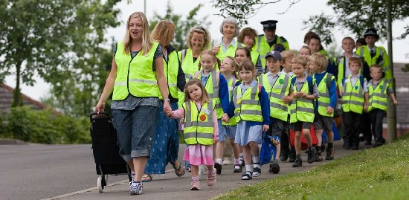

Get Behind ‘Walking Buses’
Encourage people to stop using cars on the school run.
Create a ‘Park Run’–style app for walking buses: could be called ‘School Run’.
Consider the creation of designated priority / car free routes before and after school time.
Plus: mitigation - prioritise schools as areas for greening

Slide 8
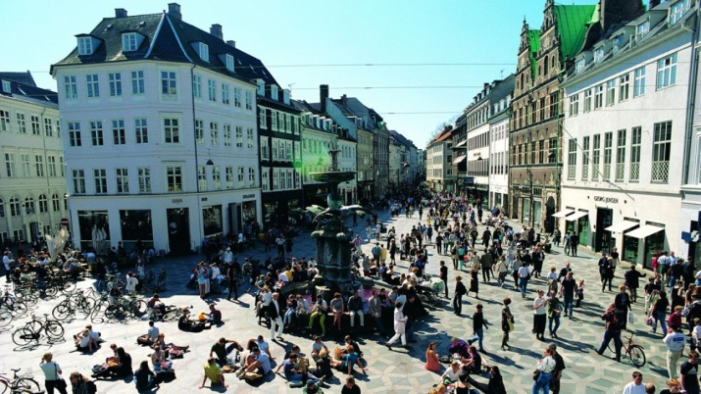
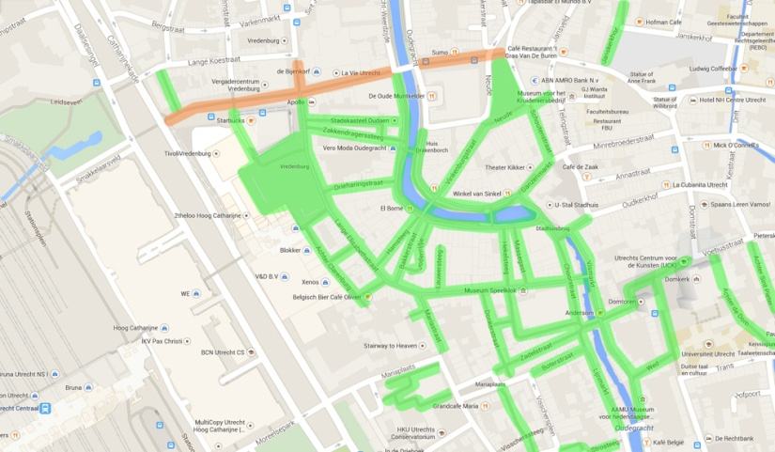
Evaluate Ealing for Pedestrianisation
The Stroget in Copenhagen was closed to motor vehicles, as an experiment, in 1962.
Cafe culture boomed and footfall in shops increased. The change was made permanent two years later.
Utrecht has a car-free centre.
Ealing is currently bisected by the Uxbridge road and railway. Could clever traffic management lead to pedestrianisation?

Slide 9
Energy

Slide 10

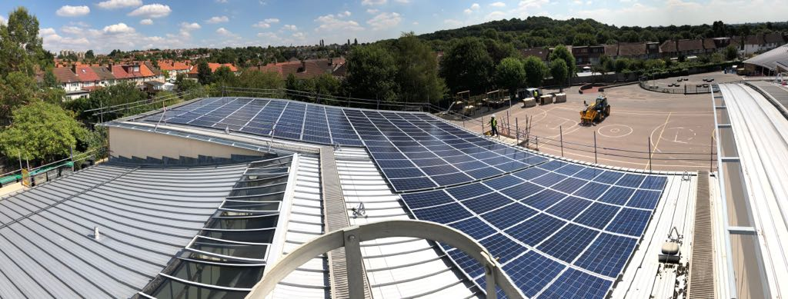
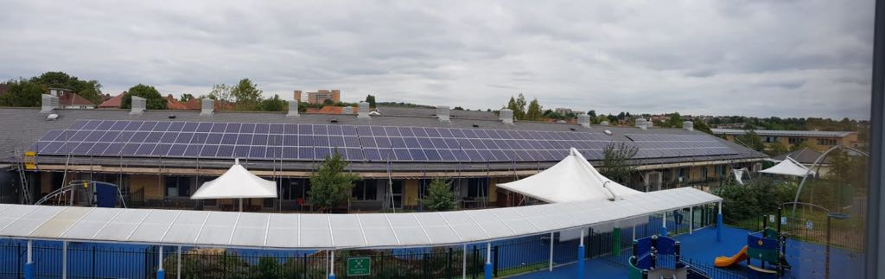
London Community Energy Fund
Mayor’s London Community Energy Fund: £400,000 to kick-start the Community Energy sector.
Ealing Transition, working with Ealing Council and SEC turned a £15,000 grant from the Mayor into £0.5Million of solar panels on 7 schools.
We have now received a second grant of £30,000 to progress further projects.
Ealing Transition and SWLEN are piloting energy audits in schools

Slide 11
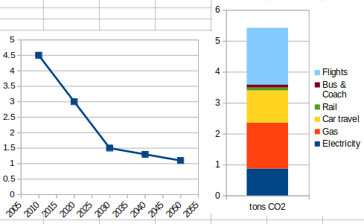
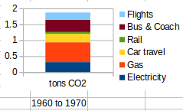
An Energy Descent Plan
In the 1960s the average house was 4 degrees cooler in winter, we took 90% less flights, and travelled approx 85% less miles

Slide 12
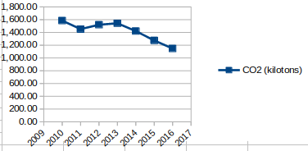
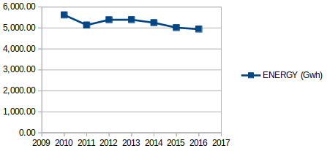
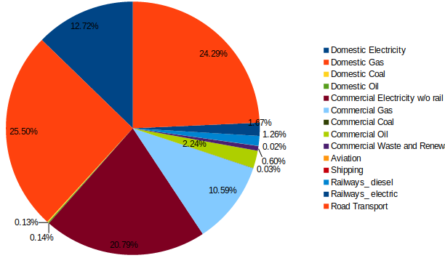
Ealing’s Energy Footprint
The London Array (175 turbines, £1.8 Billion) produces enough power for 500,000 homes or 6% of London’s Electricity (roughly the same as Ealing’s total footprint)
If all households in Ealing installed 2kWp we could provide approx half of our domestic electricity consumption

Slide 13
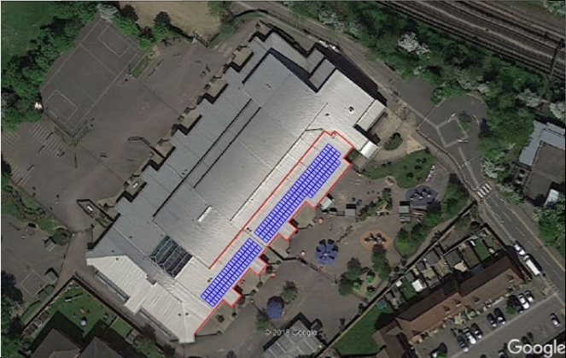
A Borough-wide Rooftop Survey
Build on work done by SEC/Ealing Transition schools solar project to survey all non-domestic roof spaces in Ealing for solar.
Work with businesses and groups like Abundance and Energy 4 All to raise capital.

Slide 14
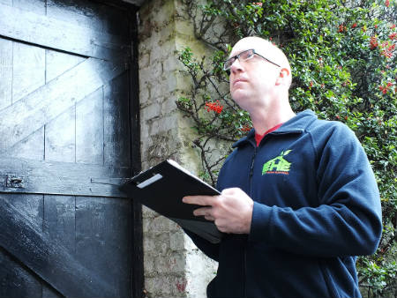
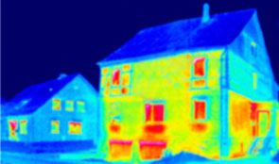
Pilot Domestic Energy Audits
A team of energy auditors working its way round the borough’s domestic housing stock (137939 households).
Fixing low hanging fruit e.g. loft insulation, incandescent / halogen bulbs, old boilers. Creating a database of the borough’s housing stock and its potential for further improvement.
Could the mayor fund a team of full-time auditors? Could we run a pilot?
https://www.ealing.gov.uk/downloads/download/1330/household_projections

Slide 15
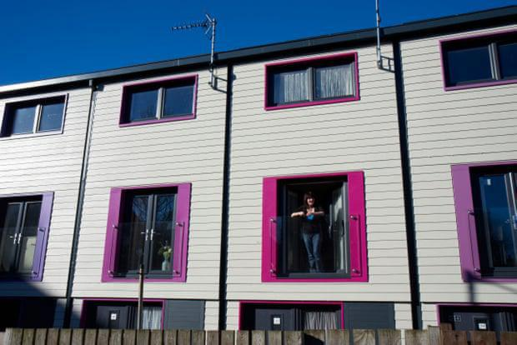

Retrofit Pilots
Next step on from energy audits.
In 2012, Oxfam reported that 4.7m jobs could be supported and £280bn added to the economy if the government invested in retro-fitting the entire existing housing stock for lower energy consumption. (It could also save a total £8.7bn a year from our domestic fuel bills.)
Our homes are the most expensive to heat in Europe, and the oldest, with more than 60% built before 1960.
Lynsey Hanley, Guardian, 15th October

Slide 16

An LED Swap-shop / Amnesty
Run a pilot scheme offering owners of incandescent or halogen bulbs LED replacements.
Could the Mayor fund this?
Switching to LED lights can also cut your carbon emissions at home. If we all switched to LEDs in our homes, together we could save about 2.7 GW of peak winter demand. That’s the same as three large fossil fueled power stations.

Slide 17

Encourage Residents to buy Clean Energy
Still the quickest and simplest way to cut emissions
https://bigcleanswitch.org/
Could a flyer go out with council tax bills?

Slide 18
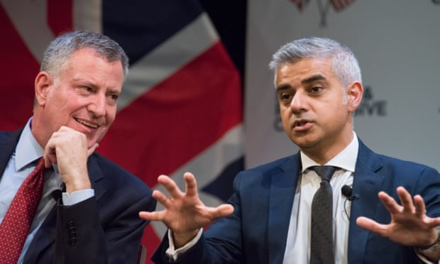
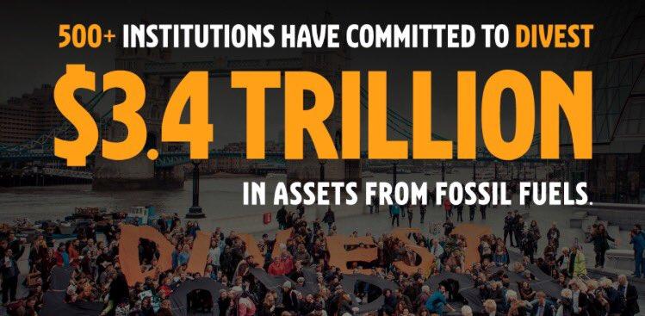
Divest from Fossil Fuels
Guardian, 10 September 2018
As New York and London mayors, we call on all cities to divest from fossil fuels
The Council, and local employers, could be encouraged to divest and re-invest in renewables.
Residents could also be encouraged to check their own pensions

Slide 19
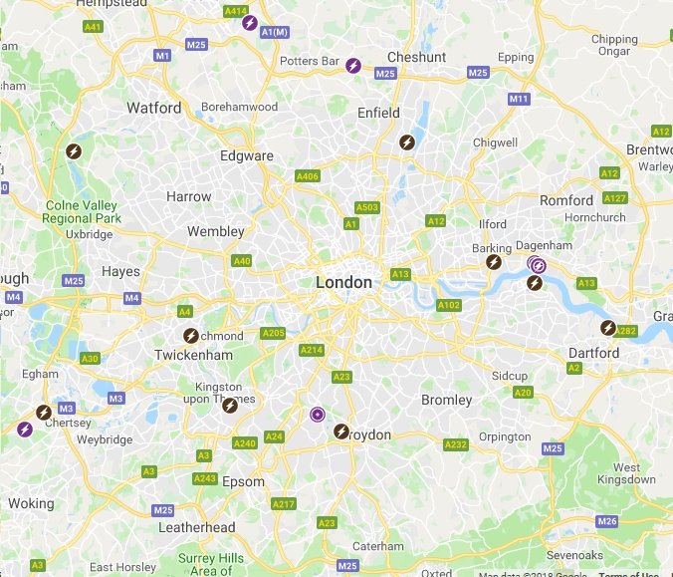

Evaluate the Potential of Energy (& Compost) from Green/Food Waste
There are 637 Anaerobic Digestion plants in the UK, about 10 of these inside the M25 http://adbioresources.org/map
Each year in London, we throw away 910,000 tonnes of food from our homes, of which 540,000 tonnes (60%) is good food and drink that we could have enjoyed. What's more, we're throwing our money away, spending £1.4 billion on food destined for the bin!
Food waste costs the average person £230 a year. For a family of four, it costs £70 a month, which adds up to more than £840 a year.
Disposing of London’s food waste costs our waste authorities over £50 million each year.
2.6 million slices of bread are thrown away every day from London households.
www.recycleforlondon.com/london-food-waste-facts

Slide 20
Greening

Slide 21


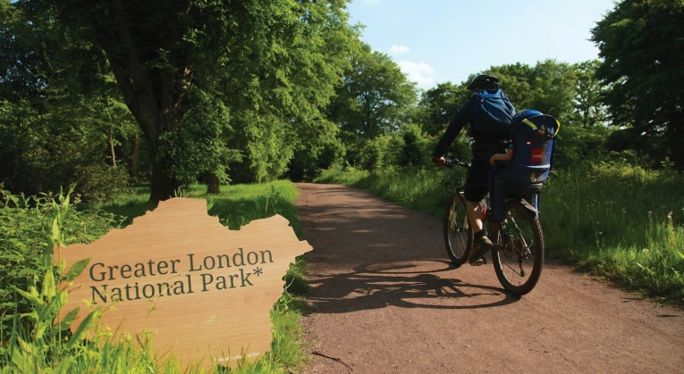
Greener City Fund
£12 Million to create the first National Park City, more than half of the
Community Tree Planting and Green Space Grants: £5 million
Strategic green infrastructure projects: £3 million to major projects including £2.1 million Green Capital grants to increase greening of the built environment.
London’s urban forest: £3 million, including £1.5 million to help create new woodlands
Community engagement: £1 million
The Greener City Fund has supported over 80 projects so far.

Slide 22

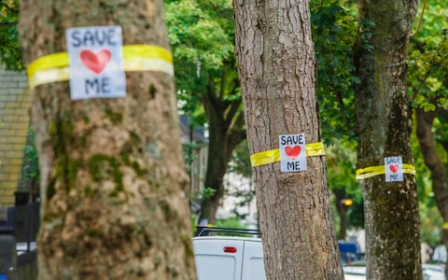
Plant Trees for Shade
Use the Mayor’s new mapping technology, which will allow us to evaluate the borough’s green space, and Greener City Fund to pilot a shade tree initiative
A study of 245 cities around the world published by the Nature Conservancy in October 2016 found that urban trees can reduce summer temperatures by as much as 6.5 degrees F. Trees also absorb carbon dioxide and other air pollution, reducing the amount of fine particulate matter emitted by factories, power plants, and cars.
Mature trees have become to be seen as a costly nuisance by some local authorities, e.g. Sheffield, which has contracted to fell '000s of mature street trees via a PFI roads maintenance contract. Network Rail have indertaken a vast programme of tree felling.

Slide 23

‘A Tree is for Life’
In conjunction with the shade trees initiative, a scheme whereby instead of buying Christmas trees, residents buy / adopt (part of or whole) ‘proper’ trees
The Mayor’s new mapping technology can help us work out where trees could be planted

Slide 24
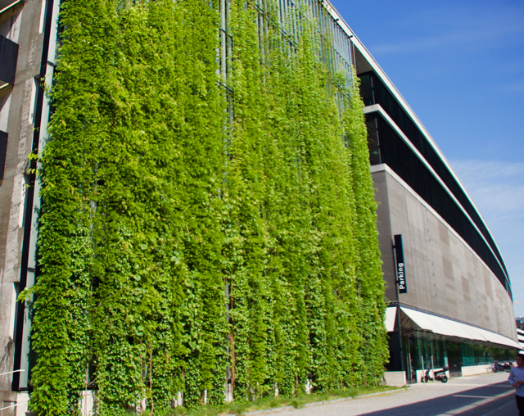
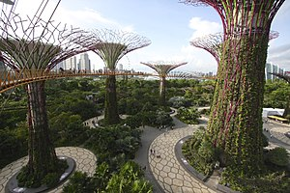
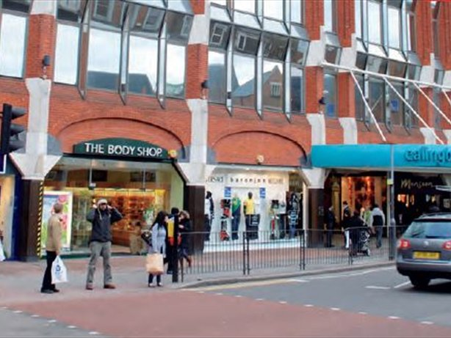
Trial a ‘Green Wall’
Is there an unattractive building that could be turned into a destination?
Could we consider something more ambitious, like Singapore’s super trees?
Again, funding is available

Slide 25
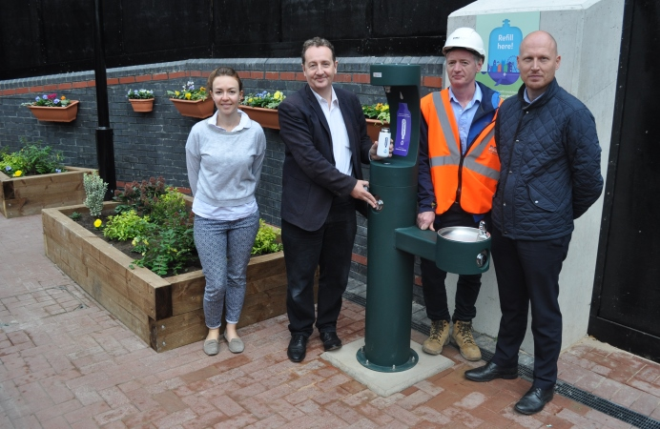
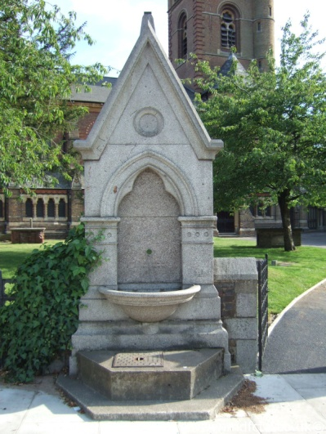
Water Fountains at Every Tube Station
Identify suitable sites borough-wide. Apply to Thames Water for connection.
Combine with Ealing-specific communication targeting single -use plastic bottles
Explore fountains that are no longer functioning e.g. St Mary’s

Slide 26
Concluding Thoughts
'There are no non-radical solutions left to climate change' Naomi Klein
'Children playing in the street should be a key indication of community well being' Mayor of Bogota

Slide 28
Ealing Council Manifesto
Transport
Slowing down traffic
Crossrail, new bus routes
Car clubs, electric vehicle charging points
Pledges on cycling / pedestrianisation (but concrete plans unclear)
Play streets / closing roads near schools
Fines for idling / polluting industries
Low Emission Zones / corridor along Uxbridge Road
Mitigation of Heathrow
Energy
Council owned energy company
Solar Together / Solar Panels
CHP
'Reduce pension fund exposure to Carbon Industries'
LED street lamps
Trees
30,000 new trees
'There are no non-radical solutions left’

Slide 29

Priorities
Concrete plans to get us to zero carbon by 2050 (2030)
An energy descent / transition / pollution plan with solar survey / retrofit etc
Clever finance - community energy, carbon offset, money from the Mayor, redeploying pension funds, green bonds

Slide 30


The Imperative
We have 12 years to limit climate change catastrophe, warns UN
Urgent changes needed to cut risk of extreme heat, drought, floods and poverty, says IPCC
The authors of the landmark report by the UN Intergovernmental Panel on Climate Change (IPCC) said urgent and unprecedented changes are needed to reach the target, which is affordable and feasible although it lies at the most ambitious end of the Paris agreement pledge to keep temperatures between 1.5C and 2C.
Debra Roberts, a co-chair of the IPCC working group, said: “It’s a line in the sand and what it says to our species is that this is the moment and we must act now. This is the largest clarion bell from the science community and I hope it mobilises people and dents the mood of complacency.”

Slide 31
Introduction
This is a document produced as a result of 3 community events on the theme of Sustainable Cities.
At the first we explored what cities around the world are doing to manage the transition away from the current fossil-fuel dependent, car-centric paradigm. At the second Dr Katherine Drayson of the GLA presented the Mayor’s Environmental Strategy.
What follows is not a series of demands, rather a series of ideas that we believe members of Ealing Transition might have the energy to make happen.
We hope to use the framework of the Mayor’s Plan, the funding streams the GLA have made available, and the model we have created for the schools’ energy project to pilot some of these initiatives. The emphasis is on low-cost, low capital projects.
This document will evolve as the community shapes it further. Our plan is to run an ‘Open Space’ event early next year to set some of these initiatives in motion.

Slide 32

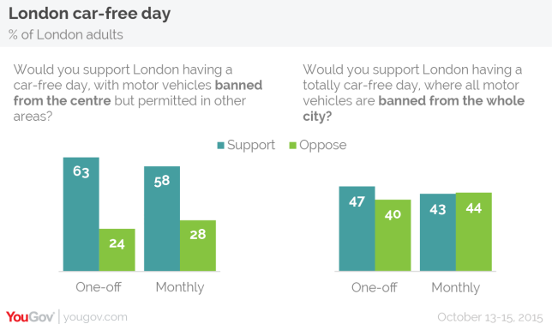
Establish Ealing’s energy use and develop an energy descent action plan. How much energy could Ealing produce? How much could be saved through energy efficiency?
Roughly eight million people in Greater London, which covers an area of around 1.5 thousand square kilometres, or 600 square miles.
According to DECC, annual electricity consumption in Greater London is just under 40,000 GWh. This is, on average, 4.5 gigawatts.
This could be supplied by a couple of big coal or nuclear power plants. A typical nuclear power plant is made up of two 1.3 or so GW units, which have capacity factors of around 90%. So, London could be supplied by a couple of regular sized nuclear power plants. The London Array wind farm covers 100 square kilometres of sea in the English Channel. This provides the equivalent of 6% of London’s electricity demand.
https://carboncounter.wordpress.com/2014/12/11/how-big-would-a-wind-farm-need-to-be-to-power-london

